Slide 1

Mental Health Detection
Guided By
Dr. P.P.Shinde
Presented By
Pradip Sonawale

Slide 2
Introduction
Mental health is a significant concern globally, impacting millions of individuals and their families.
It is estimated that approximately 300 million people worldwide suffer from depression, which accounts for 13% of all diseases.
Moreover, 25% of people experience mental health issues at some point in their lives, indicating the major this problem.
The causes can be diverse, including work-related stress, financial struggles, family problems, relationship difficulties, violence, and environmental factors.
Detection traditionally relies on in-person interviews and surveys, but technological advancements have opened doors to improved diagnosis methods.

Slide 3

Objectives
Our objectives include encouraging awareness about behaviors that improve mental health, implementing preventative measures, promoting open communication, and improving tests and examinations for early detection.

Slide 4
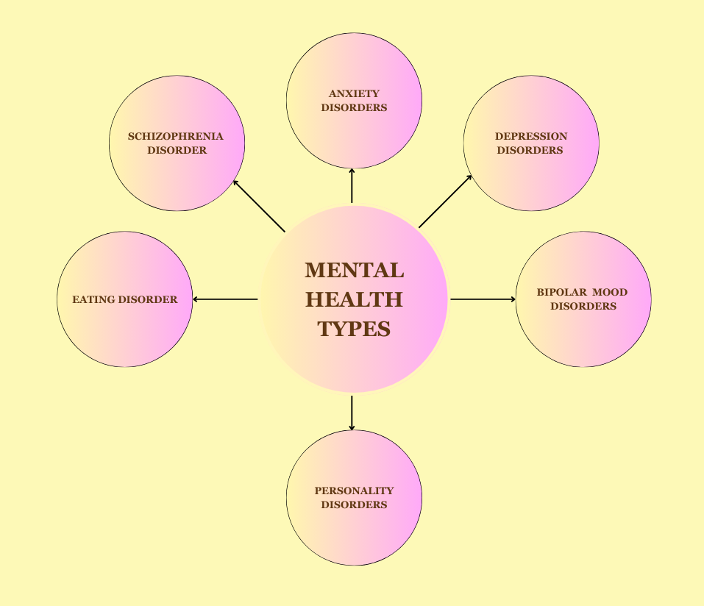
Types of Mental Health Problems

Slide 5
Impact of Mental Health Conditions
Psychological Effects
Social Challenges
Mental health conditions profoundly impact an individual's psychological well-being, affecting their ability to function in day-to-day life.
These conditions can result in difficulties at work, in family relationships, and societal interactions, leading to a significant social impact.

Slide 6


Challenges in Mental Health Diagnosis
Inaccurate Diagnosis
Stigma Associated
The complexity of mental health conditions sometimes leads to misdiagnosis, necessitating a more accurate diagnostic approach.
The stigma surrounding mental health often prevents individuals from seeking help and understanding their condition, proving to be a significant roadblock.

Slide 7

Data Mining for Mental Health
1
Research and Analysis
Utilizing data mining techniques, we aim to identify patterns and insights in mental health data that can help in early detection and intervention.
2
Machine Learning Algorithms
We are employing advanced machine learning algorithms such as Random Forest to analyze real-time datasets and achieve high accuracy in mental health condition identification.

Slide 8
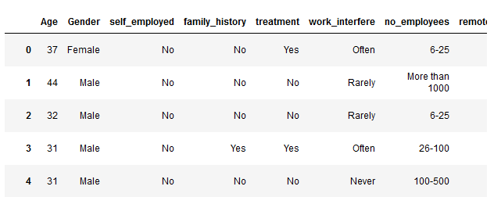
Data Collection and Data Pre-processing
Collect datasets from the Kaggle website. Matches dataset Delivery dataset
Data Cleaning by removing NULL values Selecting the necessary features
The final dataset used for the model is below:
Splitting the final dataset is 80% for training and 20% for testing.
Fig 1. Final Dataset

Slide 9
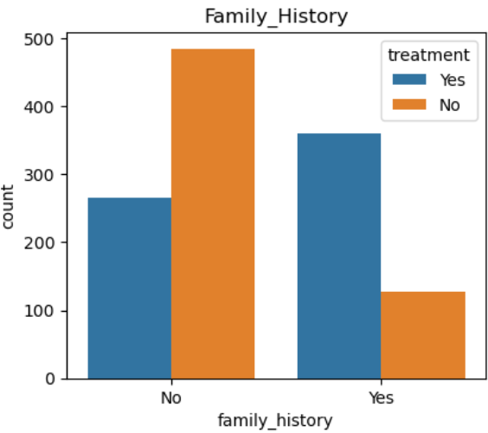
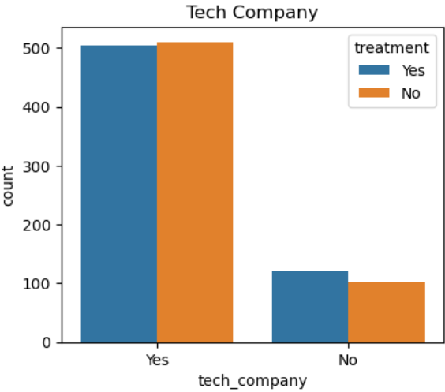
Data Analysis
Fig 2. Mental health Occurrence based on family history
Fig 3. Mental health Occurrence based on tech company

Slide 10
Algorithm | Accuracy
K-NN | 75.40
Naïve Bayes | 79.43
Decision Tree | 77.82
Random Forest | 84.67
SVM | 79.83
Logistic Regression | 80.64
Data Accuracy of Algorithms
Fig 4. Algorithm accuracy table
Fig 5. Algortihms accuracy visualization

Slide 11
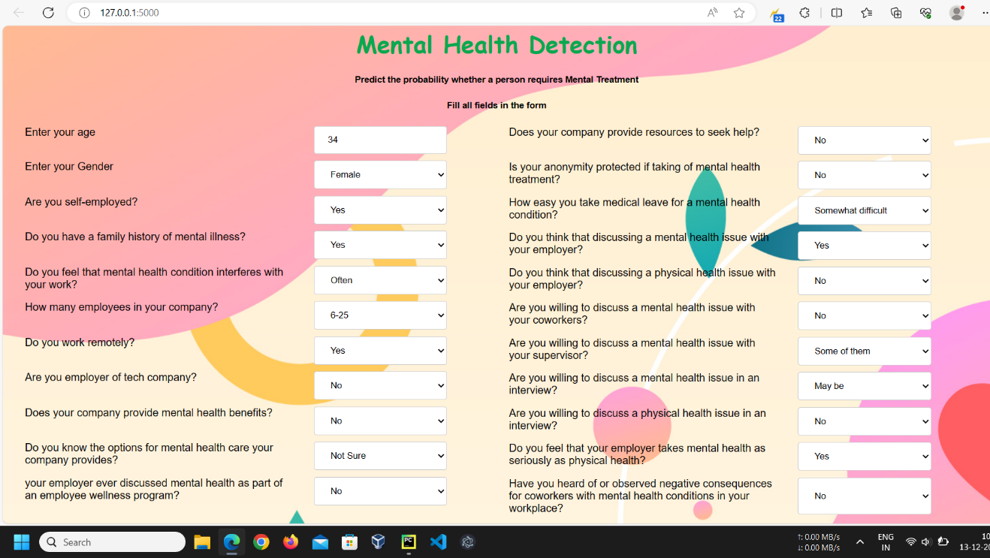
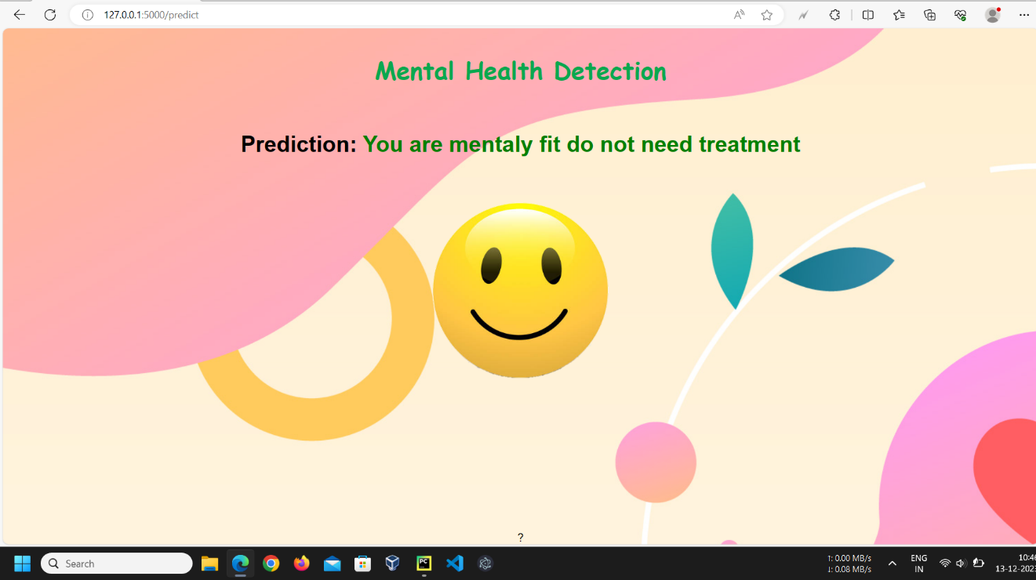
Demo Of Website Output

Slide 12
Conclusion
In conclusion, the future of mental health care lies in the integration of technology, the use of data-driven approaches, and the development of personalized treatment plans.
By leveraging advanced technology, mental health care can be improved, and by utilizing data-driven approaches, diagnosis and intervention can be enhanced.
Furthermore, personalized treatment plans tailored to individual needs can provide more effective and efficient care.
These advancements hold great promise for the future of mental health care.

Slide 13


